Slide 1
Aircraft Cost Analysis
Michele Tuccillo
March 14, 2025

Slide 2
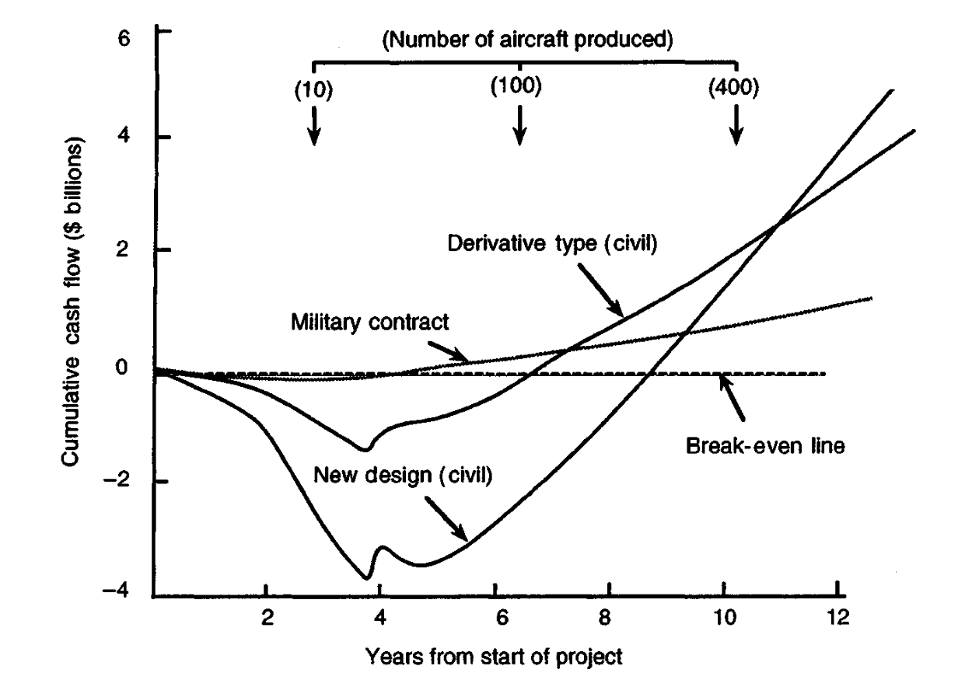
Introduction
An important part of the aircraft design process is the analysis of all cost items associated with the production and operations of the vehicle.
The 5 Questions of Investors:
How much will I invest in a new program?
How many airplanes do I need?
How will it cost to operate them?
When will I get a revenue?
How much will I get from the business?
Cost of a new program. Jenkinson L.R., Simpkin P., Rhodes D. Civil Jet Aircraft Design (1999).

Slide 3
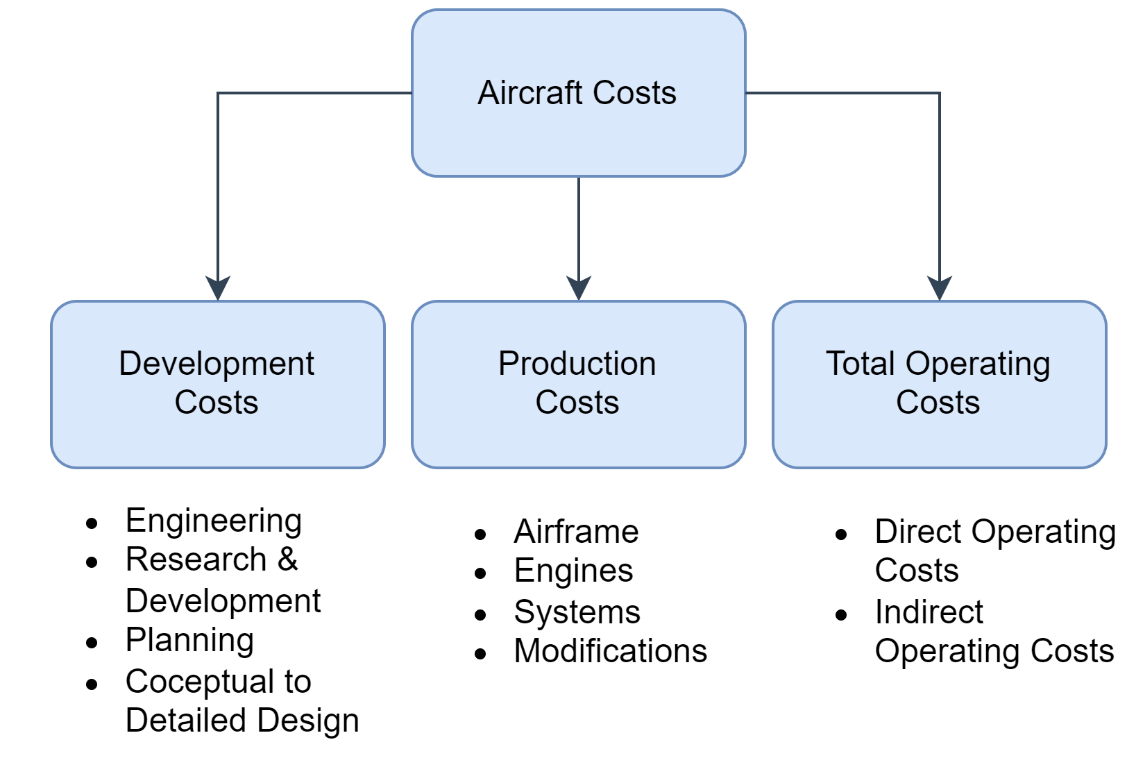
Aircraft Cost Items
In the aerospace industry, the term life-cycle-cost (LCC) refers to the sum of all cost item associated with the operations of an aircraft, from its acquisition, operating life, to its end-of-life.
The main cost classes include:
Development costs;
Production costs;
Total Operating costs.
Adapted from: Airplane Design – Part VIII by Dr. Jan Roskam

Slide 4
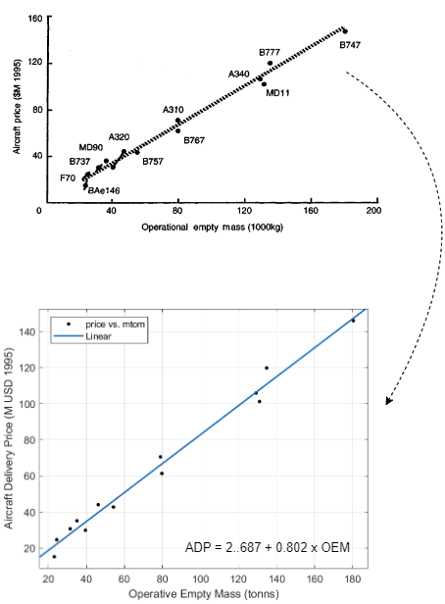
Development & Production Costs
Development and production costs lead to a first estimation of the aircraft delivery price.
During the conceptual and preliminary design phases, two classes of methodologies can be found for the analysis of such cost items.
L0: statistical methods, the aircraft delivery price (ADP) is usually a results of a simple polynomial regression of historical data.
Typical L0 methodologies require the only knowledge of the aircraft maximum take-off mass (MTOM), or, more commonly, the operative empty mass (OEM). Data is then collected, in a specific class of vehicles (large transport, business jet, regional turboprop), to derive a polynomial regression equation.
Linear regression for the ADP. Jenkinson L.R., Simpkin P., Rhodes D. Civil Jet Aircraft Design (1999).

Slide 5
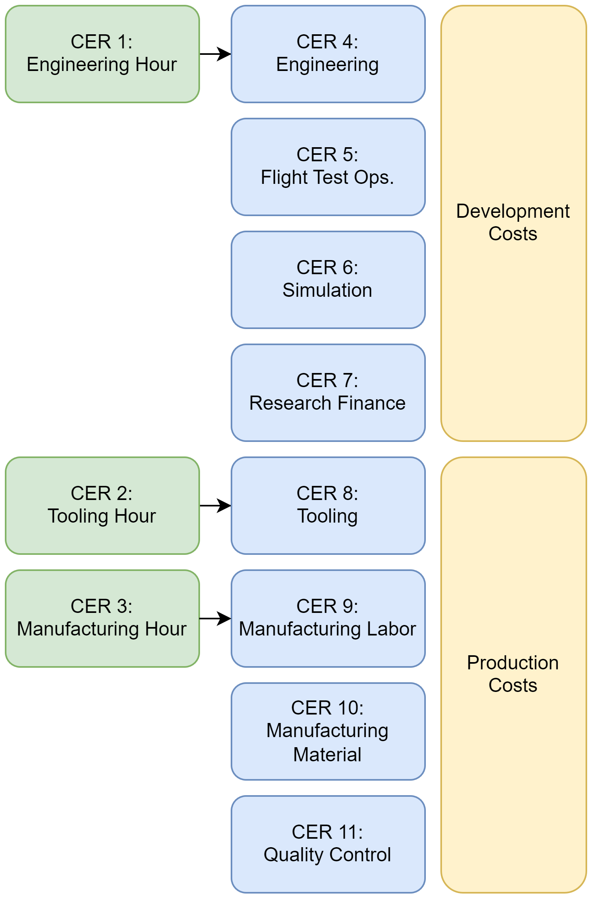
Development & Production Costs
Development and production costs lead to a first estimation of the aircraft delivery price.
During the conceptual and preliminary design phases, two classes of methodologies can be found for the analysis of such cost items.
L1: empirical equations, often referred to as cost estimating relationships (CER), connecting historical trends with industry-based knowledge.
CER-based equations are typically implemented in the preliminary design stage, where performance and a mass breakdown of the aircraft are available. The build-up of the CERs for each component in the development and production class enable the estimation of the aircraft delivery price.
The most common CERs can be found in:
Gudmundsson S. General Aviation Aircraft Design. Butterworth-Heinemann, Elsevier. (2022).
Roskam J. Airplane Design – Part VIII (1990).
Example of CER breakdown.
Adapted from Gudmundsson S. General Aviation Aircraft Design. Butterworth-Heinemann, Elsevier. (2022).

Slide 6
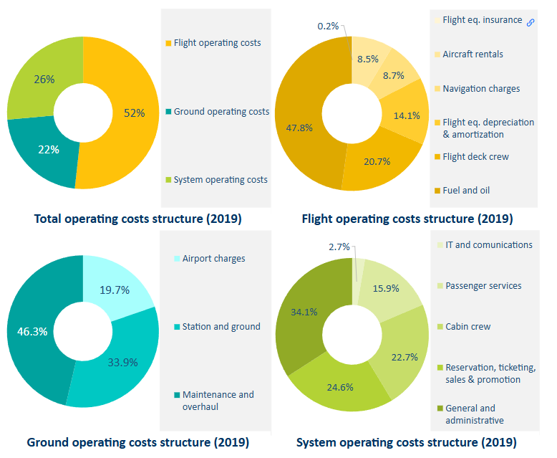
Total Operating Costs
Methodologies developed over the years tend to classify total operating costs (TOC) in different ways, usually depending on the point of view of the primary user of the methods.
The IATA Airline Cost Management Group (ACMG) divides TOCs in three categories: flight operations, directly related to the flight activities of the aircraft, ground operations, connected to tasks performed on ground, such as maintenance, airport handling and systems costs, including cost items necessary to make the aircraft «operative», such as crew costs, passenger services, communication.
The 2109 report of the IATA ACMG provides an overview of the different cost items in each category, as well as an example of the breakdown of such items and their percentage in composing operational expenditures.
Split of total operating costs. IATA report 2019. Ref. EUROCONTROL

Slide 7
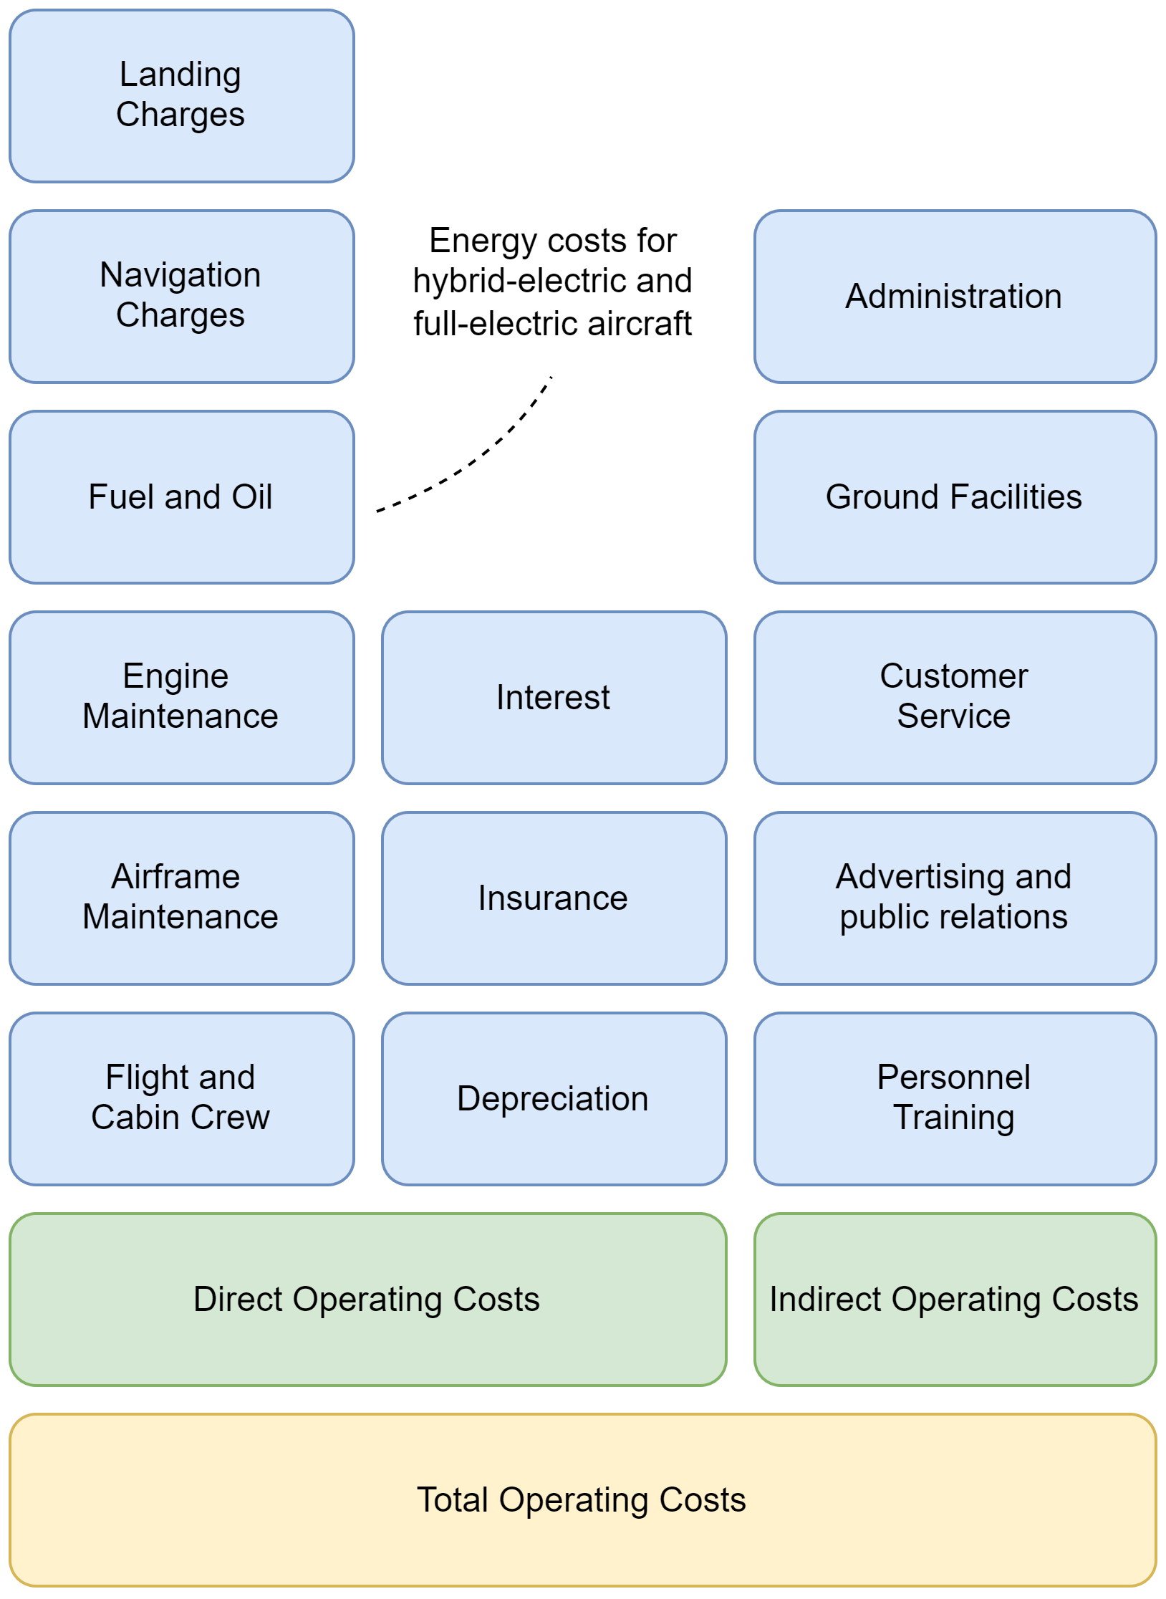
Total Operating Costs
The integration of cost analysis methodologies in the preliminary design stages led to a different categorization of TOCs, usually to ease cost-driven design space explorations and optimizations.
Early models developed towards this approach include the Air Transportation Association (ATA) method (1967) and the Association of European Airlines (AEA) method (1989). TOCs are classified in Direct Operating Costs (DOC) and Indirect Operating Costs (IOC).
The AEA and ATA methods share the same formulation for many cost items, main differences can be found in capital costs (depreciation, insurance and purchase interests) and in the total maintenance costs. The same classification has been adopted also by more recent methodologies, such as the simplified TU Berlin model [1].
[1] Scholz D., Thorbeck J. TU Berlin DOC Method. 3rd Symposium on Collaboration in Aircraft Design, 19.09.2013, Linköping, Sweden

Slide 8
Direct Operating Costs Drivers
The following table illustrates the main cost drivers, applicable to all three cited methodologies.
 | Method | Drivers | Note
Crew | AEA/ATA/TU Berlin | # Crew members, yearly salary, flight hours. | U.S. Bureau of Labor Statistics
Fuel and Oil | AEA/ATA/TU Berlin | Fuel Consumption and fuel unit price. | IATA Fuel Price Monitor
Energy | - | Energy consumption (electricy and/or hydrogen) and energy price.
Maintenance | AEA/ATA/TU Berlin | OEM, Engines Mass, Maintenance Labor Rate, Flight Time, Number of Engines, Engine Static Thrust or Power. | Based on empirical relations with different functional dependencies.
Navigation Charges | AEA/ATA/TU Berlin | MTOM, block range, Unit Rates. | Unit Rates defined by EUROCONTROL.
Landing Charges | AEA/ATA/TU Berlin | Number of passengers, MTOM, unit rate. | TNC unit rate defined by the airport.
Emission Charges | AEA/ATA | Certified noise level, CO emission mass, NOx emission mass, emission unit rate fee. | Usually depending on the origin and destination airport.

Slide 9
Direct Operating Costs Drivers
Capital Costs
The ATA and AEA methodologies share the same approach in determining capital costs (depreciation, interests and insurance), both require the analysis of the aircraft delivery price, of the total investment and assumptions on interests rate and insurance rate.
TU Berlin methodology modified the main drivers for computing capital costs, replacing the knowledge of the aircraft delivery price and of the total investment with items of the weight breakdown of the aircraft, specifically, the OEM and the engines’ weight.
 | AEA | ATA | TU Berlin
Depreciation | Total Investment, depreciation period, aircraft residual value. | Total Investment, depreciation period, aircraft residual value. | OEM, Engine Weight, Depreciation Period, Aircraft Residual Value
Interests | Total Investment, Annual Rate | Total Investment, Annual Rate | OEM, Annual Rate, Engine Weight
Insurance | Aircraft Delivery Price, Insurance Annual Rate | Aircraft Delivery Price, Insurance Annual Rate | OEM, Engine Weight, Insurance Annual Rate

Slide 10
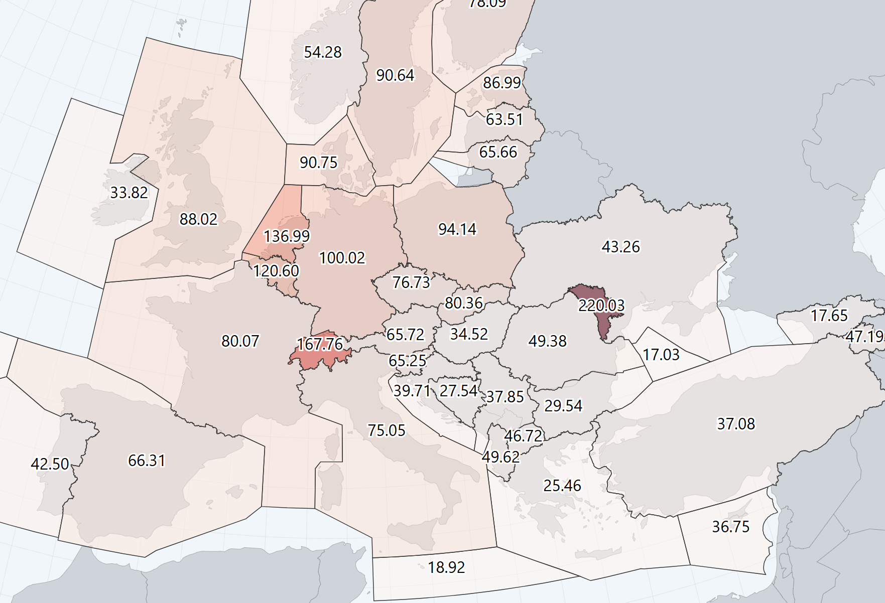
Direct Operating Costs Drivers
Navigation Charges
Navigation charges are divided in En-Route Navigation (ENR) Charges and Terminal Navigation Charges (TNC).
In Europe, EUROCONTROL represents the reference for computing both components. AEA, ATA and TU Berlin approaches strongly depend (or even duplicate) on its standard and accepted formulation. The main element composing the charges include the aircraft MTOM, the distance flown in the reference IFR region and the unit rates.
Both rates are published by EUROCONTROL. ENR unit rates are published on a monthly basis while TNC unit rates are shared once a year.
Terminal Unit Rate 2025 – EUROCONTROL
ENR Unit Rate February 2025 - EUROCONTROL
ENR Rates for February 2025. Ref. EUROCONTROL

Slide 11
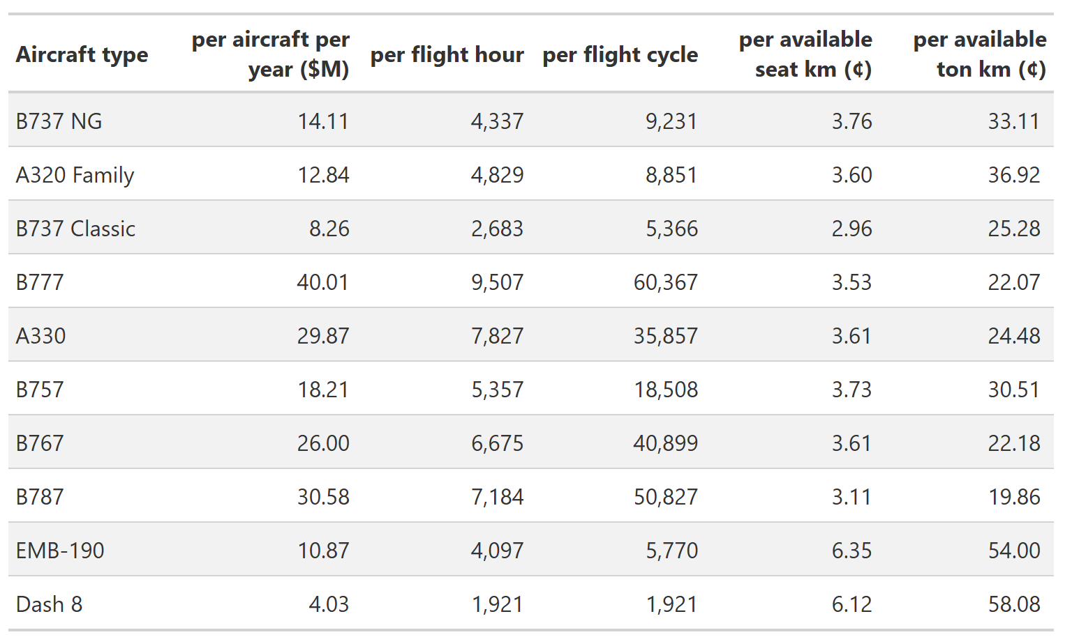
Additional Cost Indicators
DOC and TOC strongly depend on the distance flown affecting both flight time and fuel consumption.
Additionally, the average passenger load factor in a commercial flight is less than one (aircraft flying with empty seats), reducing the airline revenue. For this reason additional cost indicators have been derived from the analysis of DOC.
CASK. Cost per Available Seat-Kilometre, it ’ is the average cost of flying one seat for a kilometre. CASK is calculated by dividing the total operating cost by number of seats and kilometres flown (ASK).
Yield. Revenue of a flight divided by the number of sold tickets (sold seats) and kilometres flown. The multiplication of the last two items is also known as Revenue Passenger Kilometres (RPK).
Total operating cost and CASK. Ref. EUROCONTROL Standard Inputs for Economic Analyses
Considering a passenger load factor usually less than one, then RPK is always less than ASK.

Slide 12
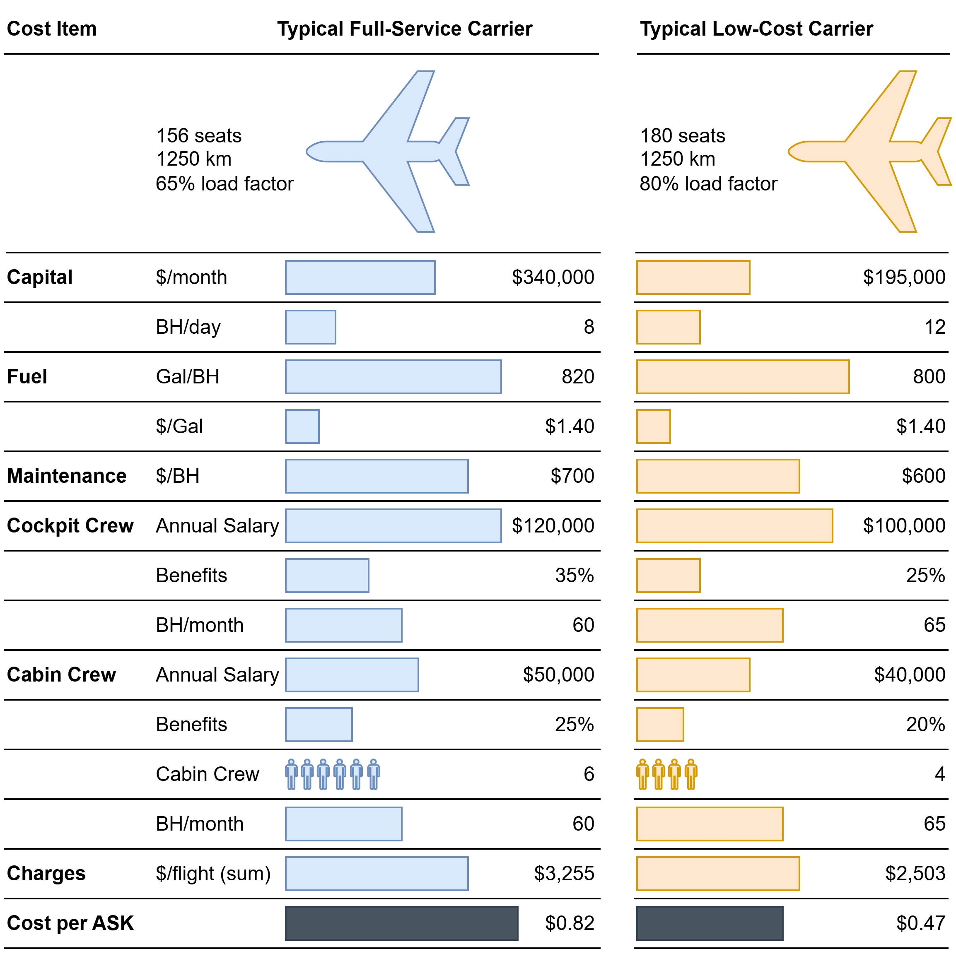
Comparing Operating Costs
Using aggregated metrics, such as CASK, to perform trade-off between similar configurations may lead to biased results.
Different airlines, when buying an aircraft, require different internal arrangement for the cabin compartment, usually with low-cost carriers having a larger seat density. Additionally, airlines operating in the same region might work on different networks, with different travelled kilometres.
Seat density and flown distance, affecting the denominator of the CASK, would result in different unit costs, providing no specific reasons for differences in costs and no insights on those cost items having the biggest impact. A more useful approach, in performing comparisons and trade-offs, consist of performing drivers-based analysis of cost components [2].
[2] Saxon S., Weber M. A better approach to airline costs. McKinsey & Company. Travel, Transport & Logistics July 2017.
Drivers-based analysis. Adapted from [2].

Slide 13
Aircraft Cost Analysis References
List of Useful References
Long Range Aircraft AEA Requirements, Brüssel: AEA, 1989 (G(T)5655)
Short-Medium Range Aircraft AEA Requirements, Brüssel: AEA, 1989 (G(T)5656)
ICAO, annex 16, 2008.
Harris, F. D., An Economic Model of U.S. Airline Operating Expenses, NASA/CR2005-213476, NASA Ames Research Center, Moﬀett Field, California, 2005.
AIR TRANSPORT ASSOCIATION OF AMERICA: Standard Method of Estimating Comparative Direct Operating Costs of Turbine Powered Transport Airplanes, Washington D.C. , ATA, 1967
Jenkinson, L., Simpkin, P., and Rhodes, D., Civil Jet Aircraft Design, Arnold Publishers and AIAA, 1999.
Roskam, J. (1997). Airplane Design VIII - Method for estimating operating cost of commercial airplanes, Lawrence, Kansas: DAR Corporation.
P. M. Sforza, Commercial Airplane Design Principles, Butterworth-Heinemann, Boston, 2014.
D. Scholz, Design Evaluation/DOC, http://www.fzt.haw-hamburg.de/pers/Scholz/HOOU/
A. Isikveren, Section 6 - Operating Economics. Initial Sizing & Analysis Techniques, University of Bristol, 2005
Franz K., Lammering T., Risse K., Anton E. and Hoernschemeyer R., Economics of Laminar Aircraft Considering Oﬀ-Design Performance, Institute of Aeronautics and Astronautics (ILR), RWTH Aachen University, 52062 Aachen, Germany, 2012.
Scholz D., Thorbeck J. TU Berlin DOC Method. 3rd Symposium on Collaboration in Aircraft Design, 19.09.2013, Linköping, Sweden.

